Slide 1
APPLICATION OF COMPUTATIONAL INTELLIGENCE TECHNIQUES
Intelligent Healthcare Support System
Prediction • Uncertainty reasoning • Optimization
TEAM
205125094 - Sanket Yadav — Neural Network
205125026 - Bitthal Kumar Tejra — Mamdani Fuzzy Logic
205125076 - Prem Sagar Prajapat — Evolutionary Computation
205125040 - Himanshu Choudhary — Ant Colony Optimization
205125100 - Shreya — Genetic–Neural System
205125046 – KC Amirdavarshini — Neuro-Fuzzy System (ANFIS)
Course project presentation | Prototype for learning and decision support

Slide 2
INTELLIGENT HEALTHCARE SUPPORT SYSTEM
Objectives and team responsibilities
Sanket
Neural Network
Binary heart-disease classification
Bitthal
Mamdani Fuzzy Logic
Predict a risk score from symptoms and health indicators using fuzzy logic.
Prem
Evolutionary Computation / GP
Allocate limited hospital resources—beds, doctors and ICU units using Evolutionary programming.
Himanshu
Ant Colony Optimization
Simulated patient scheduling and waiting time
Shreya
Genetic–Neural System
Illustrate GA search over neural parameters
Amrida
Neuro-Fuzzy System (ANFIS)
Combine fuzzy inference with neural learning
Computational Intelligence • Academic prototype • Not clinically validated
04

Slide 3
INTELLIGENT HEALTHCARE SUPPORT SYSTEM
Dataset and target definition
UCI Heart Disease dataset
920 records
12 selected features
Binary target
Four source collections are combined in the supplied project description.
Examples: age, sex, chest-pain type, blood pressure, cholesterol, max heart rate, ST depression.
Original `num` values 0–4 are mapped to a binary label.
Reported class counts
411 • No disease (0)
509 • Disease present (1)
Computational Intelligence • Academic prototype • Not clinically validated
05

Slide 4
INTELLIGENT HEALTHCARE SUPPORT SYSTEM
Data preprocessing and leakage prevention
1. Clean
Drop identifiers; remove `ca` (reported ~66% missing). Treat zero cholesterol value as missing.
2. Impute
Median for numeric values; most-frequent for binary values; missing categories handled explicitly.
3. Encode
One-hot encode categorical variables; reported neural-network input has 23 columns.
4. Scale
StandardScaler for neural networks; fuzzy model retains original clinical units.
5. Split
Stratified 70/15/15 split with seed 42: 644 train, 138 validation, 138 test.
Fit every preprocessing transformation on training data only, then apply it to validation and test data.
Computational Intelligence • Academic prototype • Not clinically validated
06

Slide 5
MEMBER 1 — NEURAL NETWORK
Sanket | Neural Network for heart-disease prediction
Problem
Actual project MLP
Learn from clinical attributes and predict whether disease is present (1) or absent (0). Supervised binary classification.
12 selected clinical features; hidden layers ; early stopping.
12 inputs
→
Hidden layer
→
Output
The 2–3–1 network used next is only a small numerical illustration; its weights are not the trained project parameters.
Assume the following inputs to be heart rate and cholesterol level and the output is the binary classification whether heart disease is present or not.
Computational Intelligence • Academic prototype • Not clinically validated
08

Slide 6
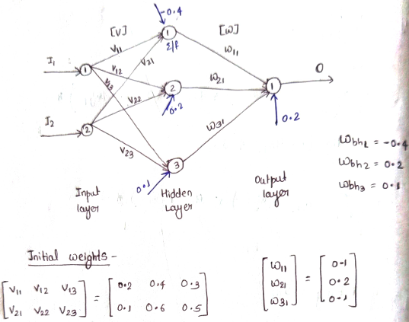
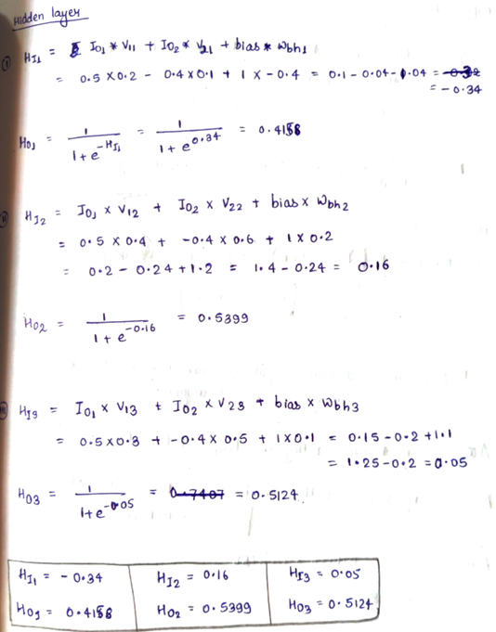
MEMBER 1 — NUMERICAL EXAMPLE
Neural Network | Worked example 1: forward propagation
Given
Interpretation
Inputs: x₁ = 0.6, x₂ = 0.8
Hidden neuron 1
z₁ = (0.5 × 0.6) + (0.4 × 0.8)
= 0.30 + 0.32 = 0.62
h₁ = ReLU(z₁) = max(0, 0.62) = 0.62
Hidden neuron 2
z₂ = (0.3 × 0.6) + (0.7 × 0.8)
= 0.18 + 0.56 = 0.74
h₂ = ReLU(z₂) = max(0, 0.74) = 0.74
Each neuron computes a weighted sum plus bias, then applies an activation function.
ReLU(z) = max(0, z)
Final hidden outputs:
h₁ = 0.62
h₂ = 0.74
These outputs become inputs to the next layer.
Computational Intelligence • Academic prototype • Not clinically validated
09

Slide 7
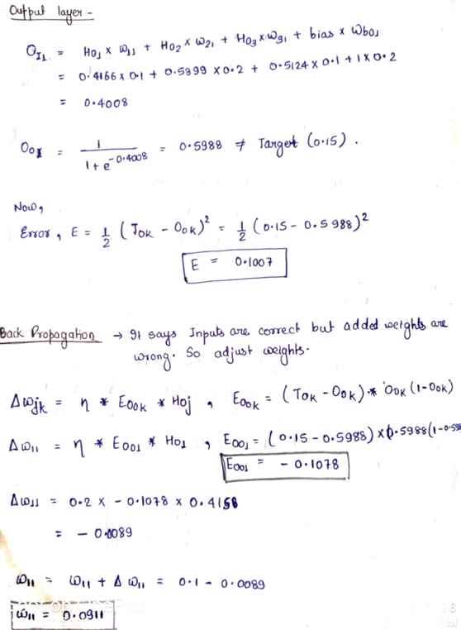
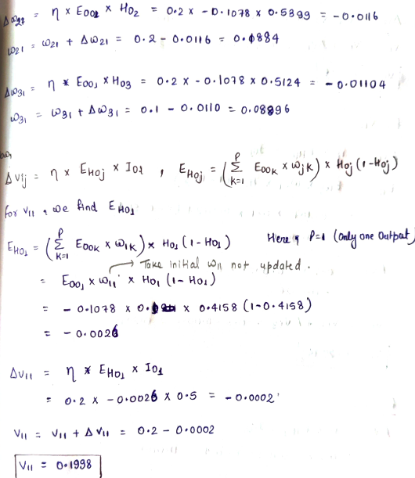
MEMBER 1 — NUMERICAL EXAMPLE
Neural Network | Worked example 2: output and learning
Prediction
Loss and one weight update
Assume v₁ = 0.8, v₂ = 0.6, bₒ = −0.5
zₒ = (0.8 × 0.62) + (0.6 × 0.74) − 0.5
= 0.496 + 0.444 − 0.5 = 0.44
ŷ = 1 / (1 + e⁻⁰·⁴⁴) ≈ 0.608
Since 0.608 > 0.5, predicted class = 1
Actual label y = 1
Binary cross-entropy: L = −ln(0.608) ≈ 0.498
δₒ = ŷ − y = 0.608 − 1 = −0.392
∂L/∂v₁ = δₒh₁ = (−0.392)(0.62) ≈ −0.243
With η = 0.1:
v₁(new) = 0.8 − 0.1(−0.243) = 0.8243
Computational Intelligence • Academic prototype • Not clinically validated
10

Slide 8
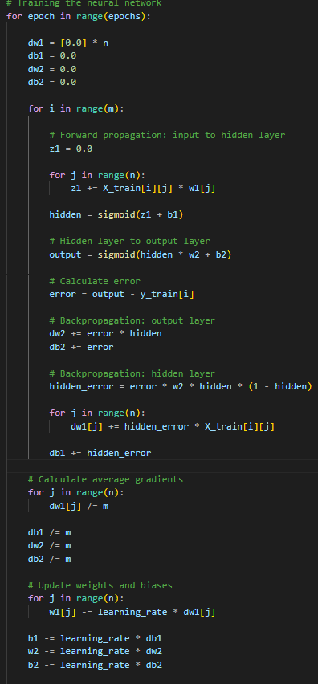
MEMBER 1 — METHODOLOGY
Neural Network | Algorithm and code
Training loop
1. Initialize weights and biases
2. Read a training example
3. Forward pass: output sigmoid
4. Calculate loss
5. Backpropagate gradients using chain rule
6. Update weights and biases
7. Repeat over epochs
8. Predict on unseen data
Computational Intelligence • Academic prototype • Not clinically validated
11

Slide 9
MEMBER 2 — FUZZY LOGIC
Bitthal | Mamdani fuzzy logic for risk estimation
Problem
Example inputs
Predict a risk score from symptoms and health indicators using fuzzy logic.
Cholesterol = 220 mg/dL
Maximum heart rate = 110 beats/min
Output: risk score from 0 to 100.
Crisp inputs
Fuzzification
Rule engine
Aggregation
Defuzzification
Clinical values
→
Membership degrees
→
IF–THEN rules
→
Combine outputs
→
One score
Classroom thresholds and three-rule example are illustrative, not medically validated.
Computational Intelligence • Academic prototype • Not clinically validated
12

Slide 10
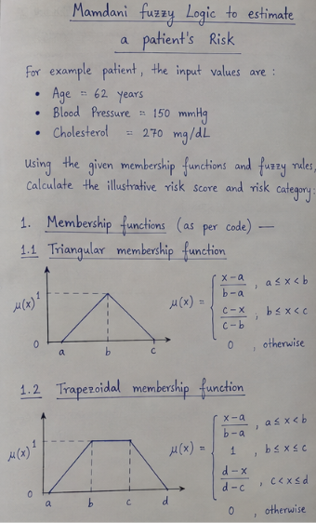
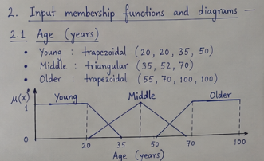
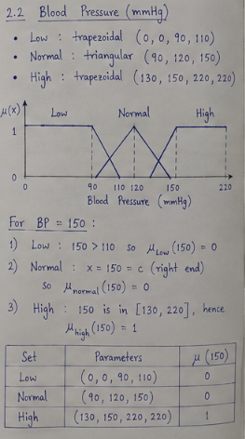
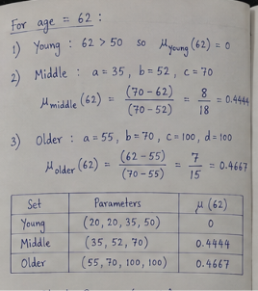
MEMBER 2 — NUMERICAL EXAMPLE
Mamdani | Worked example: fuzzification
Computational Intelligence • Academic prototype • Not clinically validated
13

Slide 11
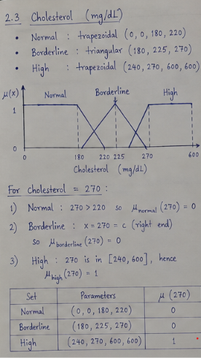
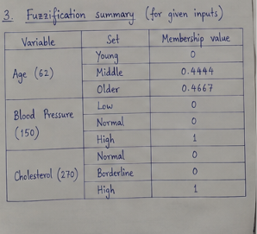
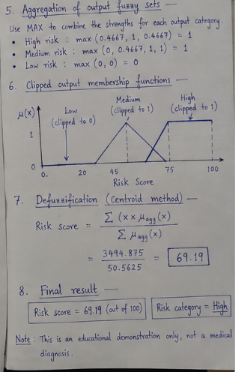
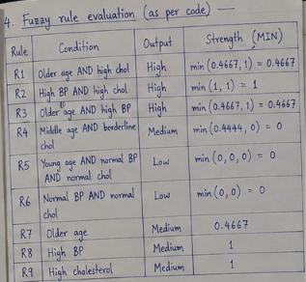
MEMBER 2 — NUMERICAL EXAMPLE
Mamdani | Rule firing and defuzzification
This is a discrete centroid approximation, not the exact continuous centroid of an aggregated output function.
Computational Intelligence • Academic prototype • Not clinically validated
14

Slide 12
MEMBER 2 — NUMERICAL EXAMPLE
Mamdani | Rule firing and defuzzification
Algorithm: Mamdani Fuzzy Logic
1. Initialize: Define input/output variables, membership functions, and 9 fuzzy rules.
2. Input: Read Age, Blood Pressure, and Cholesterol; validate their ranges.
3. Fuzzification: Calculate membership values for each input.
4. Rule Evaluation: Evaluate all 9 rules using MIN for AND.
5. Implication: Clip output membership functions using rule strengths.
6. Aggregation: Combine outputs using MAX.
7. Defuzzification: Calculate the risk score using the centroid method.
8. Classification: Score < 40 = Low, < 65 = Medium, otherwise High.
9. Display: Show risk score, category, and rules evaluated.
This is a discrete centroid approximation, not the exact continuous centroid of an aggregated output function.
Computational Intelligence • Academic prototype • Not clinically validated
14

Slide 13
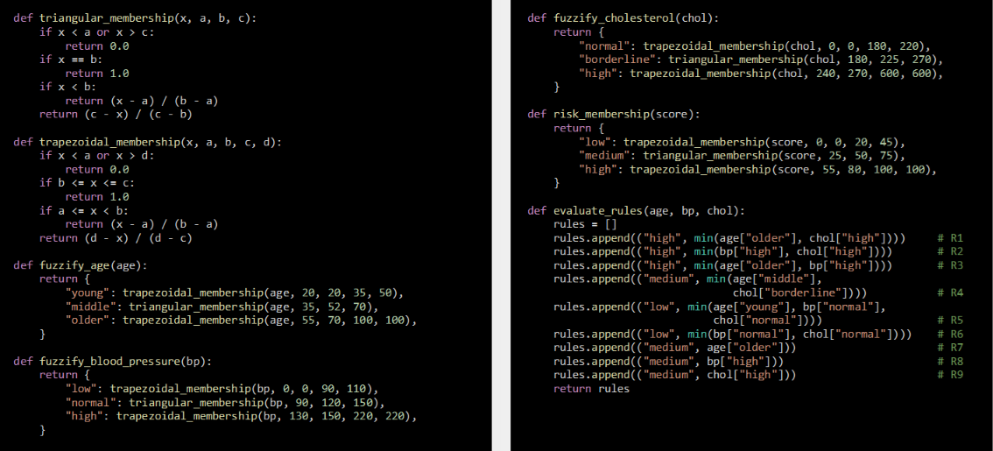
MEMBER 2 — METHODOLOGY
Mamdani | Algorithm, implementation and project connection
Algorithm
def triangle(x, a, b, c):
if x <= a or x >= c:
return 0.0
if x == b:
return 1.0
if x < b:
return (x-a)/(b-a)
return (c-x)/(c-b)
chol_low = triangle(220,120,160,240)
chol_high = triangle(220,160,240,280)
hr_low = triangle(110,60,80,120)
hr_high = triangle(110,80,120,160)
r1 = min(chol_high, hr_low)
r2 = min(chol_low, hr_high)
r3 = min(chol_high, hr_high)
1. Read cholesterol and heart rate
2. Calculate Low/High memberships
3. Evaluate each IF–THEN rule
4. Use minimum for AND firing strength
5. Clip and aggregate output fuzzy sets
6. Defuzzify using centroid
7. Return numerical score
Project description reports 20 rules and PSO tuning of membership-function parameters; verify against implementation.
Computational Intelligence • Academic prototype • Not clinically validated
15

Slide 14
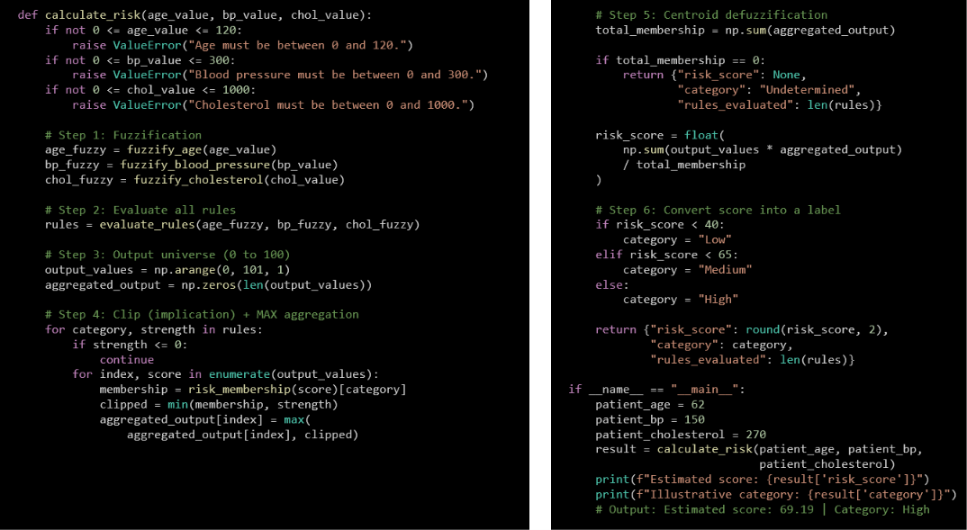
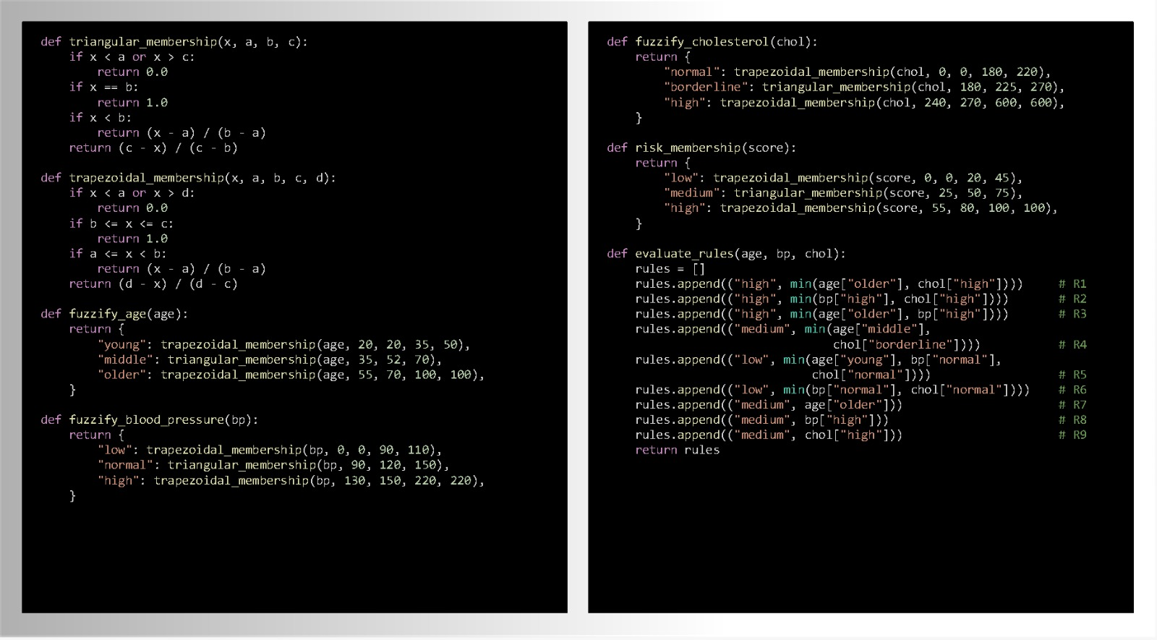
MEMBER 2 — METHODOLOGY
Mamdani | Algorithm, implementation and project connection
Algorithm
def triangle(x, a, b, c):
if x <= a or x >= c:
return 0.0
if x == b:
return 1.0
if x < b:
return (x-a)/(b-a)
return (c-x)/(c-b)
chol_low = triangle(220,120,160,240)
chol_high = triangle(220,160,240,280)
hr_low = triangle(110,60,80,120)
hr_high = triangle(110,80,120,160)
r1 = min(chol_high, hr_low)
r2 = min(chol_low, hr_high)
r3 = min(chol_high, hr_high)
1. Read cholesterol and heart rate
2. Calculate Low/High memberships
3. Evaluate each IF–THEN rule
4. Use minimum for AND firing strength
5. Clip and aggregate output fuzzy sets
6. Defuzzify using centroid
7. Return numerical score
Project description reports 20 rules and PSO tuning of membership-function parameters; verify against implementation.
Computational Intelligence • Academic prototype • Not clinically validated
15

Slide 15
MEMBER 3 — GENETIC ALGORITHM
Prem | Evolutionary computation using Genetic Algorithm
Problem
Allocate limited hospital resources—beds, doctors and ICU units—across departments to improve service capacity while accounting for unmet demand, severity and cost.
Why Genetic Algorithm?
The best allocation is not known in advance. GA searches many candidate allocations and improves them using fitness evaluation, selection, crossover and mutation.
Evolution loop
Population → fitness → selection → crossover → mutation → new population
Computational Intelligence • Academic prototype • Not clinically validated
16

Slide 16
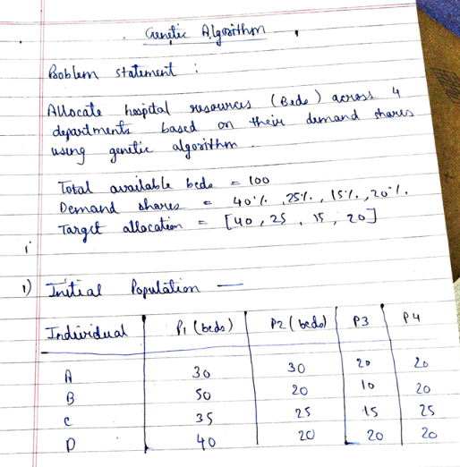
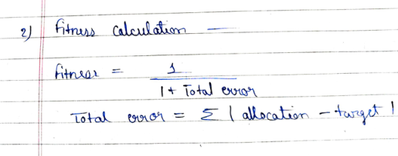
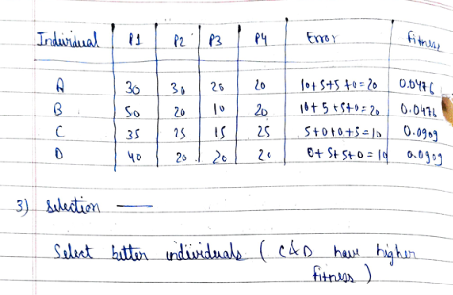
MEMBER 3 — NUMERICAL EXAMPLE
Genetic Algorithm | Worked fitness calculations
Computational Intelligence • Academic prototype • Not clinically validated
17

Slide 17
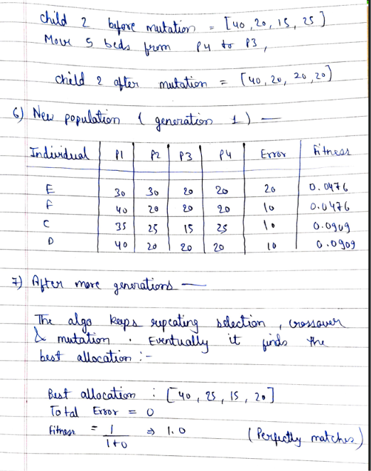
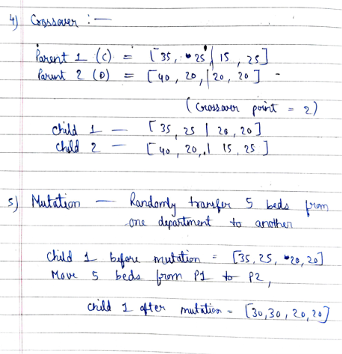
MEMBER 3 — NUMERICAL EXAMPLE
Genetic Algorithm
Computational Intelligence • Academic prototype • Not clinically validated
17

Slide 18
MEMBER 3 — METHODOLOGY
Genetic Algorithm
Algorithm: Genetic Algorithm (GA)
Initialize: Define the population size, chromosome representation, fitness function, selection method, crossover probability, and mutation probability.
Generate Population: Create an initial population of candidate solutions representing the allocation of hospital beds, doctors, and ICU resources across departments.
Fitness Evaluation: Evaluate each allocation based on patients treated, unmet demand, treatment cost, and excess resource allocation.
Selection: Select parent chromosomes using tournament selection, favoring individuals with higher fitness values.
Crossover: Apply two-point crossover to selected parents to exchange chromosome segments and generate offspring.
Mutation: Apply Gaussian mutation to randomly modify gene values and introduce diversity into the population.
Evaluate Offspring: Calculate the fitness of the newly generated allocations.
Replacement: Form the next generation and preserve the best solution found using a Hall of Fame.
Termination: Repeat selection, crossover, mutation, and fitness evaluation until the maximum number of generations is reached.
Output: Display the best resource allocation, compare it with baseline allocation methods, and generate the fitness curve and CSV result files.
Computational Intelligence • Academic prototype • Not clinically validated
18

Slide 19
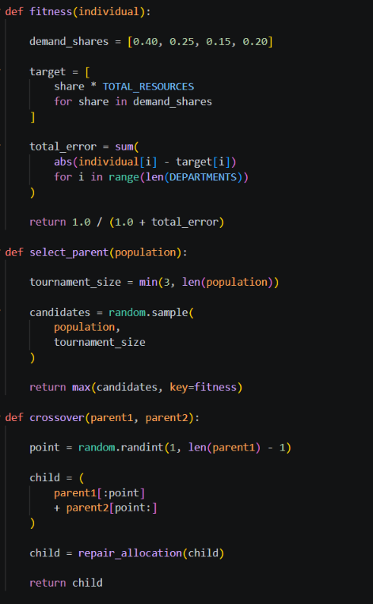
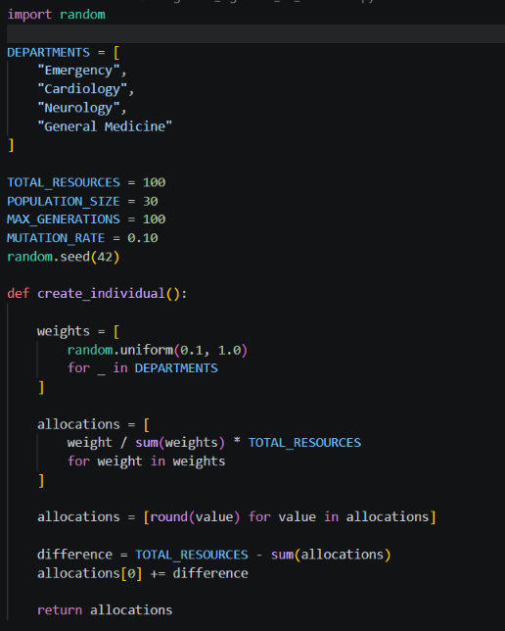
MEMBER 3 — CODE
Genetic Algorithm | Code
Computational Intelligence • Academic prototype • Not clinically validated
18

Slide 20
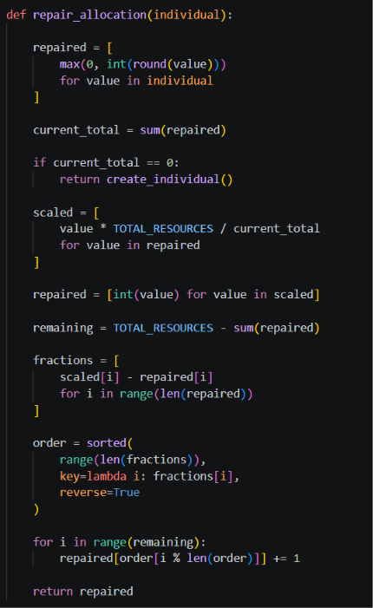
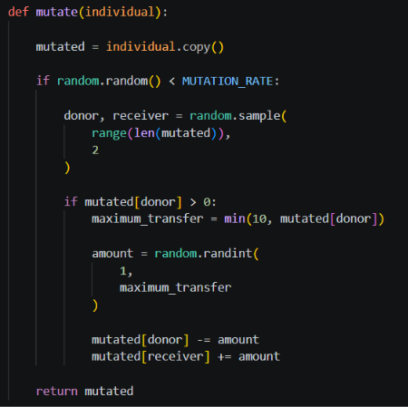
MEMBER 3 — CODE
Genetic Algorithm | Code
Computational Intelligence • Academic prototype • Not clinically validated
18

Slide 21
MEMBER 4 — ACO
Himanshu | Ant Colony Optimization for patient scheduling
Problem
ACO intuition
Build a schedule that reduces severity-weighted waiting time while respecting doctor availability and treatment duration.
Artificial ants probabilistically choose next scheduling decisions; pheromones reinforce useful choices and evaporate over time.
Pheromone τ
Heuristic η
Objective J
Learned preference for a choice.
Immediate desirability, e.g. urgency.
Minimize weighted waiting cost.
The scheduling data are synthetic. Reported improvements are simulation outcomes, not evidence of real hospital impact.
Computational Intelligence • Academic prototype • Not clinically validated
19

Slide 22
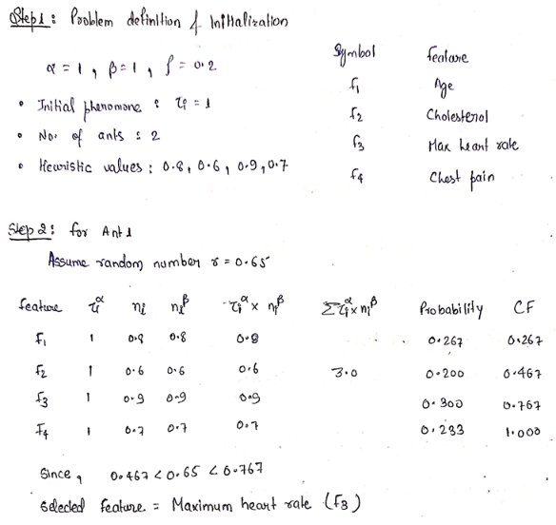
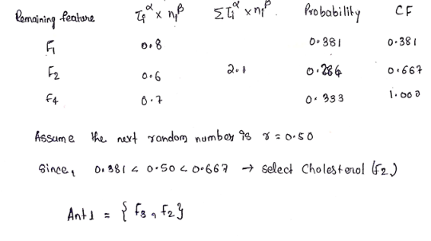
MEMBER 4 — NUMERICAL EXAMPLE
ACO | Worked example 1: selection probabilities
Probability rule
How to explain it
Given: τ₁ = τ₂ = τ₃ = 1; α = β = 1
P1: severity 2, duration 20 min
P2: severity 5 (emergency), duration 10 min
P3: severity 3, duration 15 min
Heuristic ηᵢ = severityᵢ / durationᵢ
η₁ = 2/20 = 0.10
η₂ = 5/10 = 0.50
η₃ = 3/15 = 0.20
Desirability Dᵢ = τᵢᵅηᵢᵝ
D₁ = 0.10; D₂ = 0.50; D₃ = 0.20
Total S = 0.10 + 0.50 + 0.20 = 0.80
P(P1) = 0.10/0.80 = 12.5%
P(P2) = 0.50/0.80 = 62.5%
P(P3) = 0.20/0.80 = 25.0%
Check: 12.5 + 62.5 + 25 = 100%
1. List feasible patient/doctor choices.
2. Calculate each choice's desirability, τᵅηᵝ.
3. Add desirabilities to obtain the denominator.
4. Divide each desirability by the total.
5. Select a choice probabilistically.
The supplied context does not specify the exact numerical inputs in this excerpt; use the values on your handwritten calculation sheet.
Computational Intelligence • Academic prototype • Not clinically validated
20

Slide 23
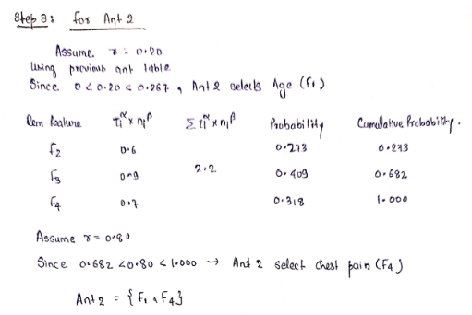
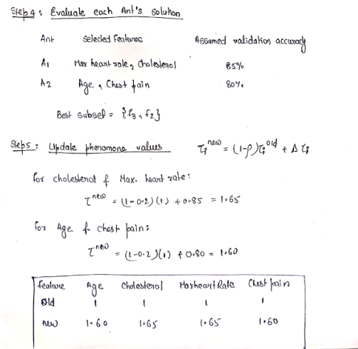
MEMBER 4 — NUMERICAL EXAMPLE
ACO | Worked example 1: selection probabilities
Probability rule
How to explain it
Given: τ₁ = τ₂ = τ₃ = 1; α = β = 1
P1: severity 2, duration 20 min
P2: severity 5 (emergency), duration 10 min
P3: severity 3, duration 15 min
Heuristic ηᵢ = severityᵢ / durationᵢ
η₁ = 2/20 = 0.10
η₂ = 5/10 = 0.50
η₃ = 3/15 = 0.20
Desirability Dᵢ = τᵢᵅηᵢᵝ
D₁ = 0.10; D₂ = 0.50; D₃ = 0.20
Total S = 0.10 + 0.50 + 0.20 = 0.80
P(P1) = 0.10/0.80 = 12.5%
P(P2) = 0.50/0.80 = 62.5%
P(P3) = 0.20/0.80 = 25.0%
Check: 12.5 + 62.5 + 25 = 100%
1. List feasible patient/doctor choices.
2. Calculate each choice's desirability, τᵅηᵝ.
3. Add desirabilities to obtain the denominator.
4. Divide each desirability by the total.
5. Select a choice probabilistically.
The supplied context does not specify the exact numerical inputs in this excerpt; use the values on your handwritten calculation sheet.
Computational Intelligence • Academic prototype • Not clinically validated
20

Slide 24
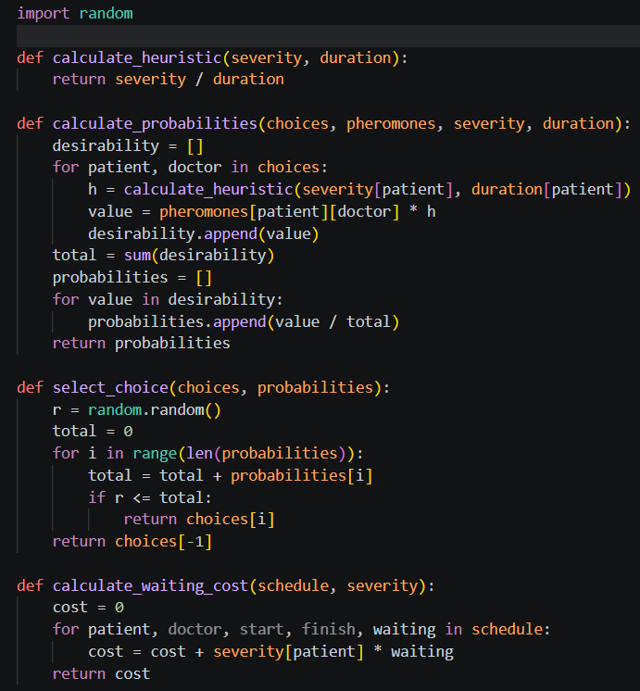
MEMBER 4 — METHODOLOGY
ACO | Pheromone update, algorithm
and code
Algorithm: Ant Colony Optimization (ACO)
Initialize: Set the number of ants, pheromone levels, evaporation rate, and maximum iterations.
Define Problem: Specify the possible paths or solutions and their heuristic information.
Construct Solutions: Each ant builds a solution by selecting the next step based on pheromone intensity and heuristic information.
Calculate Probability: Determine the probability of choosing a path using pheromone and heuristic values.
Evaluate Solutions: Calculate the cost or fitness of each ant’s solution.
Find Best Solution: Identify the best solution from the current iteration and update the global best if improved.
Update Pheromones: Evaporate existing pheromones and deposit new pheromones on paths used by ants.
Repeat: Repeat solution construction, evaluation, and pheromone updates until the maximum iterations or stopping condition is reached.
Output: Display the best solution and its total cost.
Project setup described: three doctors and emergency arrivals; waiting-time outcomes are simulated and metric units were not specified.
Computational Intelligence • Academic prototype • Not clinically validated
21

Slide 25
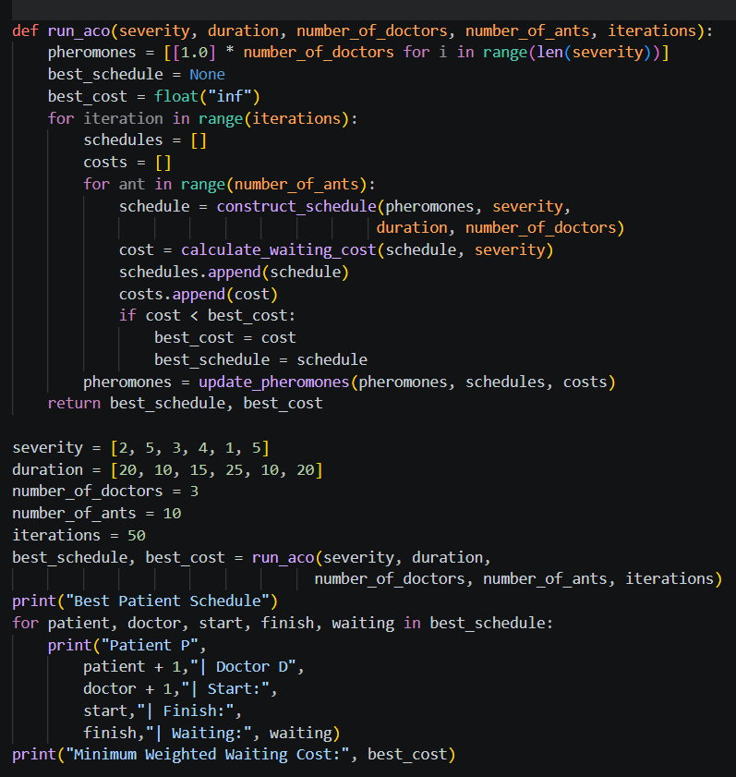
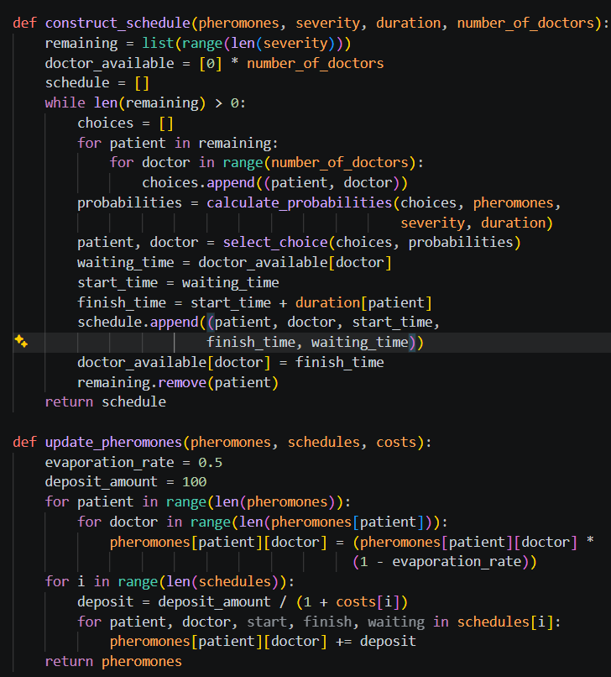
MEMBER 5 — METHODOLOGY
ACO | Algorithm and code sketch
Pseudocode shows the hybrid workflow; it is not evidence that the complete Neuro-GA model is implemented.
Computational Intelligence • Academic prototype • Not clinically validated
24

Slide 26
MEMBER 5 — HYBRID TECHNIQUE
Shreya | Genetic–Neural System (Neuro-GA)
Problem
Chromosome
Neural networks require optimal weights, biases, and architecture for accurate predictions. A Genetic Algorithm (GA) can optimize these parameters to improve model performance.
Encode a candidate set of neural parameters; evaluate its fitness using prediction error.
Encode
Evaluate
Select
Vary
Repeat
Candidate weights / biases
→
Forward pass + error
→
Prefer fitter candidates
→
Crossover + mutation
→
Keep best candidate
This section is an educational hybrid demonstration unless the repository contains a complete Neuro-GA training pipeline.
Computational Intelligence • Academic prototype • Not clinically validated
22

Slide 27
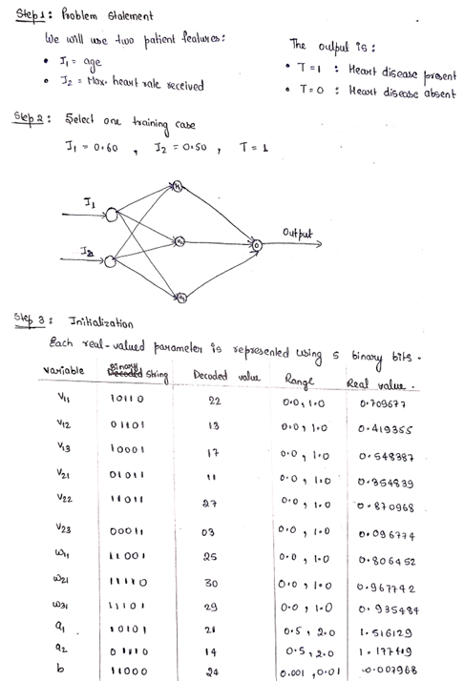
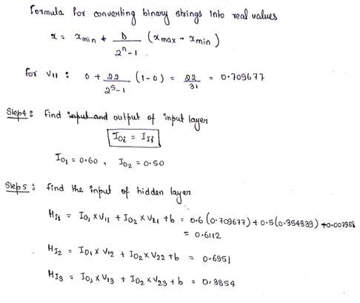
MEMBER 5 — NUMERICAL EXAMPLE
Neuro-GA | Worked forward pass and error
What the GA does next
For an illustrative candidate chromosome:
z = w₁x₁ + w₂x₂ + b
ŷ = σ(z) = 1 / (1 + e⁻ᶻ)
For a binary target y, squared error:
E = ½(y − ŷ)²
The supplied class example reports error ≈ 0.1425 for its selected sample.
1. Encode weights/biases as a chromosome.
2. Evaluate each chromosome with a fitness function.
3. Select parents.
4. Apply crossover to combine parameter segments.
5. Mutate one or more genes.
6. Re-evaluate offspring and retain promising candidates.
Fitness might be based on error; lower error is better.
Computational Intelligence • Academic prototype • Not clinically validated
23

Slide 28
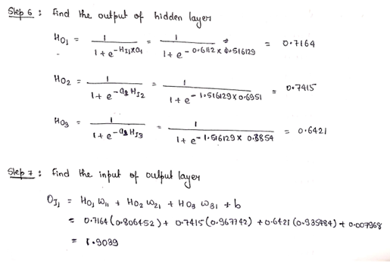
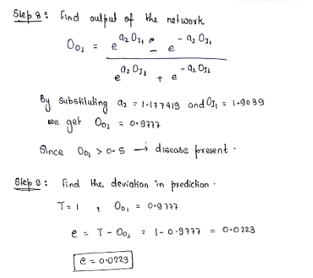
MEMBER 5 — NUMERICAL EXAMPLE
Neuro-GA | Worked forward pass and error
What the GA does next
For an illustrative candidate chromosome:
z = w₁x₁ + w₂x₂ + b
ŷ = σ(z) = 1 / (1 + e⁻ᶻ)
For a binary target y, squared error:
E = ½(y − ŷ)²
The supplied class example reports error ≈ 0.1425 for its selected sample.
1. Encode weights/biases as a chromosome.
2. Evaluate each chromosome with a fitness function.
3. Select parents.
4. Apply crossover to combine parameter segments.
5. Mutate one or more genes.
6. Re-evaluate offspring and retain promising candidates.
Fitness might be based on error; lower error is better.
Computational Intelligence • Academic prototype • Not clinically validated
23

Slide 29
MEMBER 5 — METHODOLOGY
Neuro-GA | Algorithm and code sketch
1. Initialize population
Generate multiple GA-strings representing candidate neural networks.
2. Decode each GA-string
Convert the binary bits into real-valued weights, bias and transfer coefficients.
3. Calculate network outputs
Perform forward calculations and calculate prediction error for the training cases.
4. Evaluate fitness and select
Use MSD as the error-based fitness measure. Prefer candidates with lower MSD.
5. Apply crossover and mutation
Create new candidate GA-strings and repeat the evaluation.
6. Select the best candidate
After the stopping condition is reached, use the best candidate's parameters as the optimized neural network.
Pseudocode shows the hybrid workflow; it is not evidence that the complete Neuro-GA model is implemented.
Computational Intelligence • Academic prototype • Not clinically validated
24

Slide 30
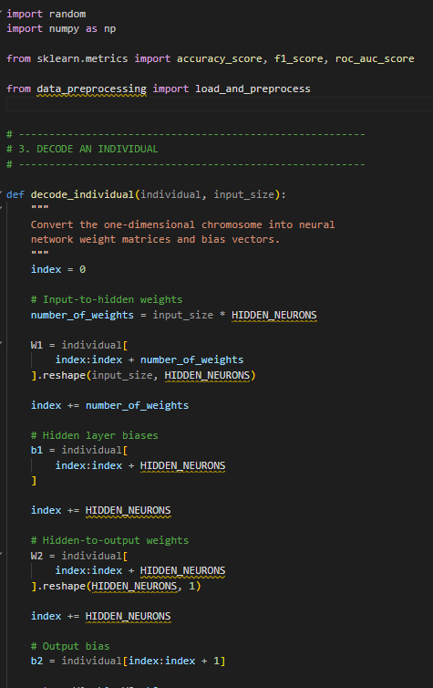
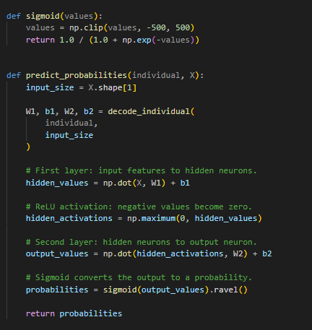
MEMBER 5 — METHODOLOGY
Neuro-GA | Algorithm and code sketch
Pseudocode shows the hybrid workflow; it is not evidence that the complete Neuro-GA model is implemented.
Computational Intelligence • Academic prototype • Not clinically validated
24

Slide 31
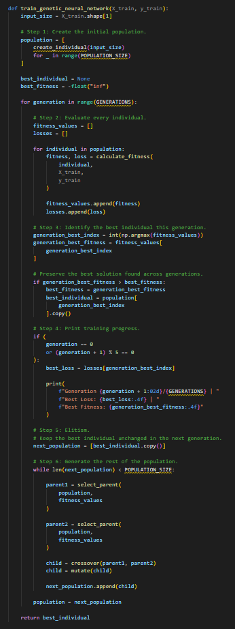
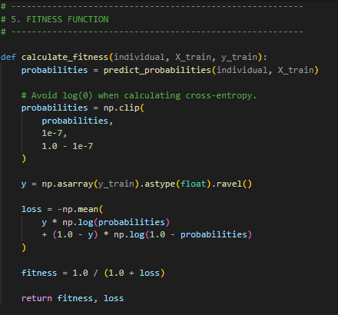
MEMBER 5 — METHODOLOGY
Neuro-GA | Algorithm and code sketch
Computational Intelligence • Academic prototype • Not clinically validated
24

Slide 32
MEMBER 6 — ANFIS
Amrida | Neuro-Fuzzy System (ANFIS)
Problem
Takagi–Sugeno model
Combine fuzzy IF–THEN rules with parameter learning to produce a numerical output from clinical attributes.
Rules produce functions of the inputs; normalized firing strengths combine rule outputs into one estimate.
1
2
3
4
5
6
Inputs
→
Memberships
→
Rule firing
→
Normalize
→
Rule outputs
→
Weighted sum
The healthcare interpretation is illustrative; the source describes the ANFIS numerical work as a classroom demonstration.
Computational Intelligence • Academic prototype • Not clinically validated
25

Slide 33
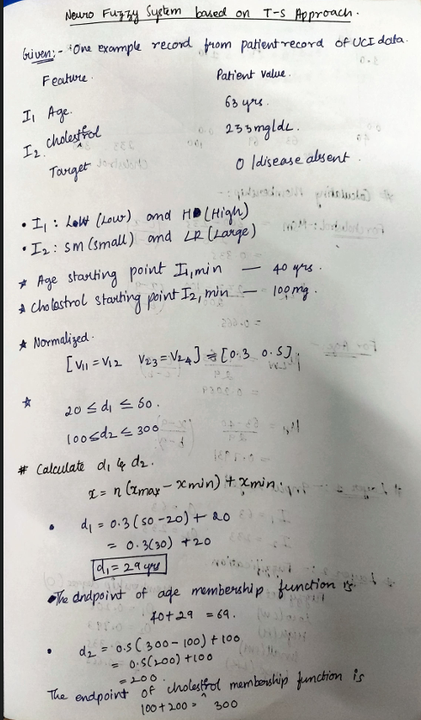
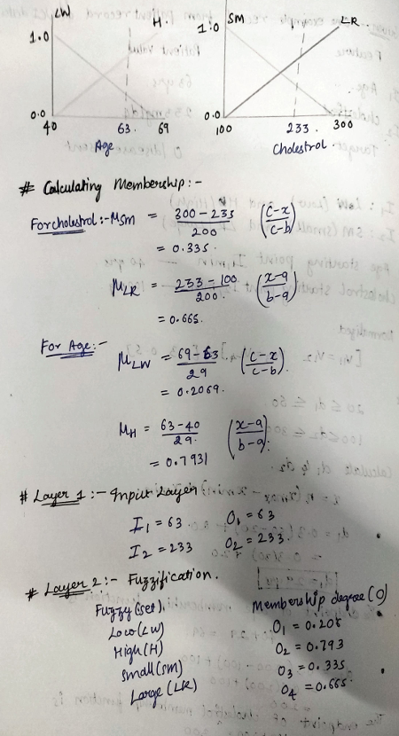
MEMBER 6 — NUMERICAL EXAMPLE
ANFIS | Worked example: rule firing and normalization
Computational Intelligence • Academic prototype • Not clinically validated
26

Slide 34
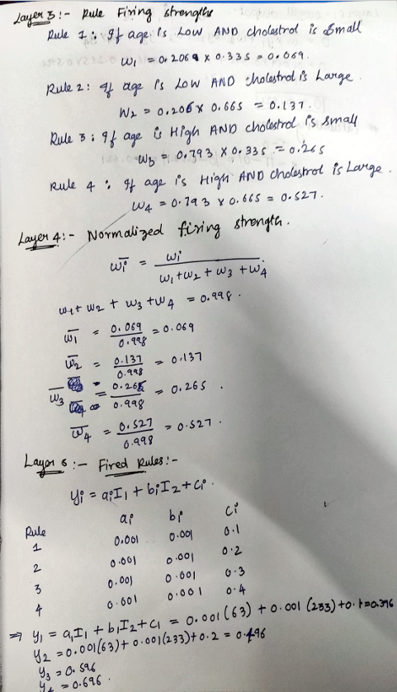
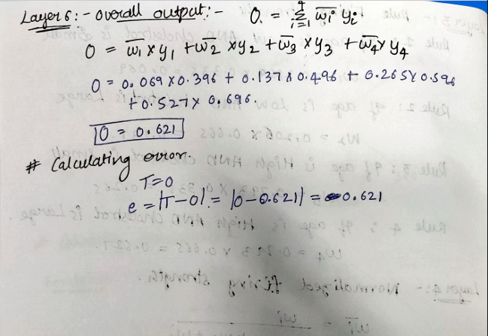
MEMBER 6 — METHODOLOGY
ANFIS | Sugeno output, algorithm and code sketch
Sugeno consequent: yᵢ = aᵢI₁ + bᵢI₂ + cᵢ
Inputs: I₁ = 1.1; I₂ = 6.0
Normalized weights: 0.72, 0.18, 0.08, 0.02
Rule outputs:
y₁ = 0.2(1.1) + 0.3(6) + 0.1 = 2.12
y₂ = 0.2(1.1) + 0.4(6) + 0.1 = 2.72
y₃ = 0.3(1.1) + 0.3(6) + 0.1 = 2.23
y₄ = 0.3(1.1) + 0.4(6) + 0.1 = 2.83
Weighted output:
O = 0.72(2.12) + 0.18(2.72)
+ 0.08(2.23) + 0.02(2.83)
= 1.5264 + 0.4896 + 0.1784 + 0.0566
= 2.251
Target T = 2.3; deviation = 2.3 − 2.251 = 0.049
# Forward-pass outline for a Sugeno ANFIS
for rule in rules:
firing[rule] = membership_product(rule, inputs)
output[rule] = consequent_function(rule, inputs)
total = sum(firing.values())
normalized = {
r: firing[r] / total for r in rules
}
prediction = sum(
normalized[r] * output[r] for r in rules
)
Each rule has a consequent function, for example:
fᵢ = pᵢx + qᵢy + rᵢ
Overall output:
ŷ = Σ(wᵢfᵢ) / Σwᵢ
Equivalent normalized form:
ŷ = Σ(ŵᵢfᵢ)
Training adjusts premise and consequent parameters to reduce prediction error.
Computational Intelligence • Academic prototype • Not clinically validated
27
Notes:
Hi

Slide 35
MEMBER 6 — METHODOLOGY
ANFIS | Algorithm and code sketch
Algorithm: Neuro-Fuzzy System
Initialize the neuro-fuzzy system and define input variables, fuzzy sets, membership functions, and rules.
Input Data: Accept the input values from the healthcare system.
Fuzzification: Convert crisp input values into fuzzy membership degrees.
Rule Evaluation: Apply fuzzy IF–THEN rules to calculate the firing strength of each rule.
Neural Network Processing: Use neural-network learning to adjust the system's parameters, such as membership-function parameters or rule weights.
Inference: Combine the activated fuzzy rules to generate the system output.
Defuzzification: Convert the fuzzy output into a crisp numerical value, if required.
Calculate Error: Compare the predicted output with the expected output when training data is available.
Update Parameters: Adjust the parameters using the learning process to reduce prediction error.
Repeat: Continue the learning process until the stopping condition is met.
Output: Return the final prediction or healthcare assessment.
Note: This is a general Neuro-Fuzzy algorithm. To make it exact for your project, I would need to check whether your implementation actually combines neural-network learning with fuzzy inference.
Computational Intelligence • Academic prototype • Not clinically validated
27
Notes:
Hi

Slide 36
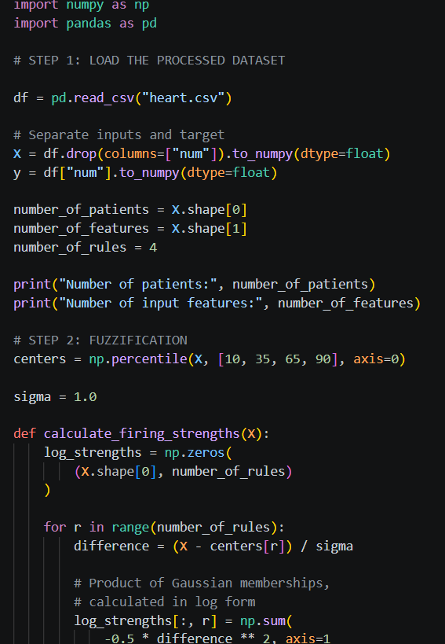
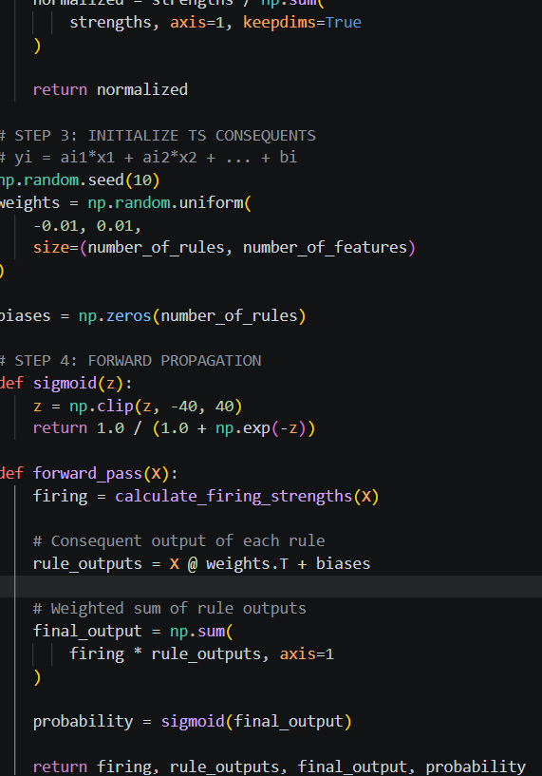
MEMBER 6 — METHODOLOGY
ANFIS | Sugeno output, algorithm and code sketch
Sugeno consequent: yᵢ = aᵢI₁ + bᵢI₂ + cᵢ
Inputs: I₁ = 1.1; I₂ = 6.0
Normalized weights: 0.72, 0.18, 0.08, 0.02
Rule outputs:
y₁ = 0.2(1.1) + 0.3(6) + 0.1 = 2.12
y₂ = 0.2(1.1) + 0.4(6) + 0.1 = 2.72
y₃ = 0.3(1.1) + 0.3(6) + 0.1 = 2.23
y₄ = 0.3(1.1) + 0.4(6) + 0.1 = 2.83
Weighted output:
O = 0.72(2.12) + 0.18(2.72)
+ 0.08(2.23) + 0.02(2.83)
= 1.5264 + 0.4896 + 0.1784 + 0.0566
= 2.251
Target T = 2.3; deviation = 2.3 − 2.251 = 0.049
# Forward-pass outline for a Sugeno ANFIS
for rule in rules:
firing[rule] = membership_product(rule, inputs)
output[rule] = consequent_function(rule, inputs)
total = sum(firing.values())
normalized = {
r: firing[r] / total for r in rules
}
prediction = sum(
normalized[r] * output[r] for r in rules
)
Each rule has a consequent function, for example:
fᵢ = pᵢx + qᵢy + rᵢ
Overall output:
ŷ = Σ(wᵢfᵢ) / Σwᵢ
Equivalent normalized form:
ŷ = Σ(ŵᵢfᵢ)
Training adjusts premise and consequent parameters to reduce prediction error.
Computational Intelligence • Academic prototype • Not clinically validated
27

Slide 37
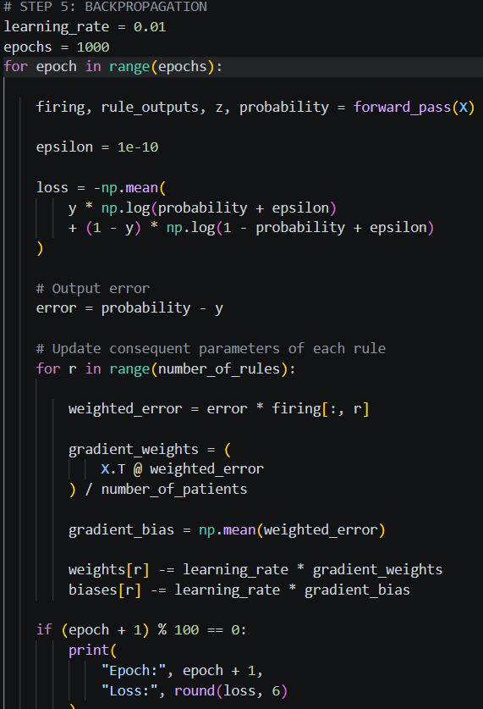
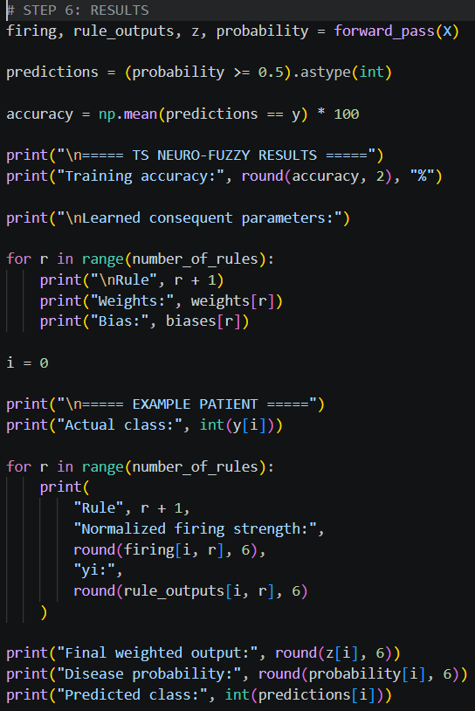
MEMBER 6 — METHODOLOGY
ANFIS | Sugeno output, algorithm and code sketch
Computational Intelligence • Academic prototype • Not clinically validated
27

Slide 38
INTELLIGENT HEALTHCARE SUPPORT SYSTEM
Results and evidence boundaries
Prediction branch
Operations branch
The supplied content describes a UCI dataset and model setup, but this final deck does not assert unverified accuracy, AUC or other model metrics.
ACO waiting-time outcomes and GA resource allocation are simulations on synthetic scenarios—not measured clinical outcomes.
Classroom demonstrations
Verification needed
GP, Neuro-GA and ANFIS worked examples explain algorithms; they should not be described as fully integrated production pipelines.
Confirm target counts, encoded feature count, model metrics and reported simulation values against the code and run logs before submission.
Principle: report only outcomes that can be reproduced from the supplied implementation and data.
Computational Intelligence • Academic prototype • Not clinically validated
28

Slide 39
INTELLIGENT HEALTHCARE SUPPORT SYSTEM
Limitations and future work
Current limitations
Future work
• Dataset and preprocessing details need code-level verification.
• Synthetic scenarios may not reflect hospital complexity.
• Educational examples simplify actual algorithms.
• Reproduce metrics with fixed seeds and held-out tests.
• Compare against transparent baselines.
• Validate scheduling with realistic operational constraints.
• Perform external clinical validation before any medical use.
Responsible-use statement
This system is a student prototype for learning and decision support. It is not a diagnostic device and must not be used to make clinical decisions.
Computational Intelligence • Academic prototype • Not clinically validated
29

Slide 40
CONCLUSION
Different CI techniques solve
complementary problems.
Neural networks learn predictive patterns.
Fuzzy logic reasons with imprecise concepts.
Evolutionary and swarm methods search for better solutions.
Neuro-fuzzy systems combine rule-based reasoning and learning.
Thank you
Questions?
Prototype only • Requires verification and external validation

